Slide 1

uDonors Blood and bone marrow donor recruitment system

Slide 2
Every 2sec someone needs blood
90% of people eligible to donate blood are not doing so
Almost 80% agree to donate if they be asked
http://www.redcrossblood.org/learn-about-blood/blood-facts-and-statistics
http://www.euro.who.int/en/health-topics/Health-systems/blood-safety/data-and-statistics

Slide 3
User stories
I have no time or ability
I am afraid it’s not safe
I am not motivated to do it
My impact is not obvious

Slide 4
Problems
The absence of a single coordination center for blood donors, recipients of blood donation centers.
Absence of donors almost all over the world.
A complex and inefficient process of finding donors.
Huge amount of blood utilization when at the same time there is a blood deficit, because of inefficient processes, bureaucracy and the "human factor”.

Slide 5
Solution
udonors is an automated system for recruiting blood and bone marrow donors.
Key goals:
Coordinate donors – centers – recipients
Reduce blood deficit
Control blood surplus
Recruit blood donors

Slide 6


How it works
Social networks monitoring
Bot platform
Web (knowledge) system

Slide 7
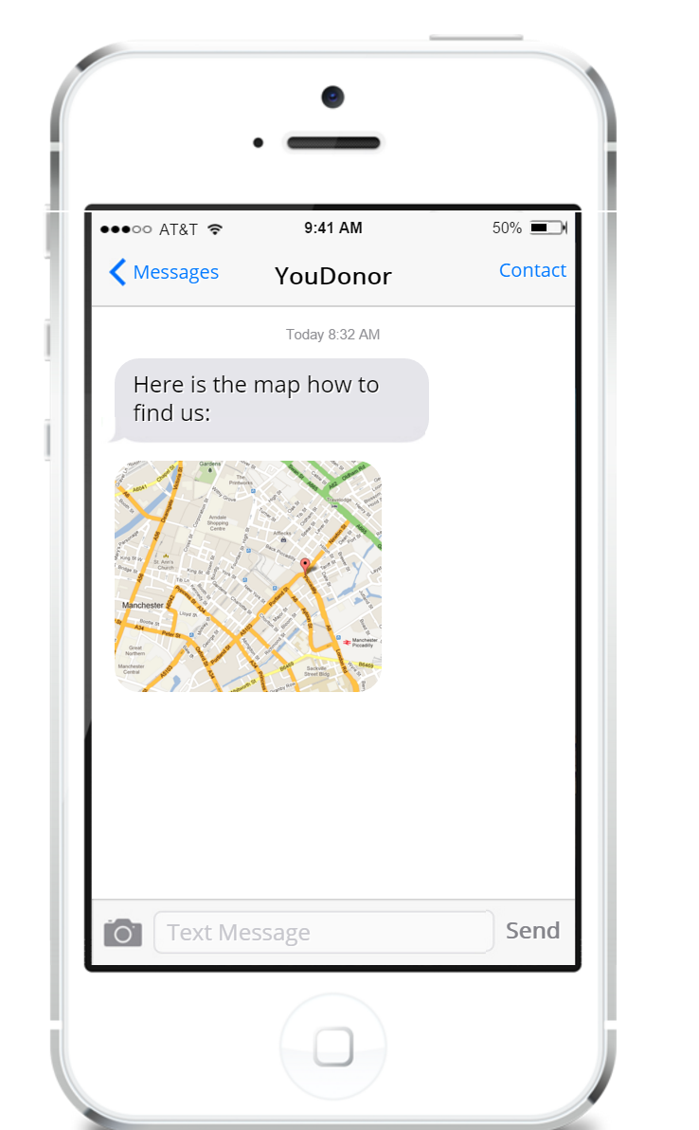
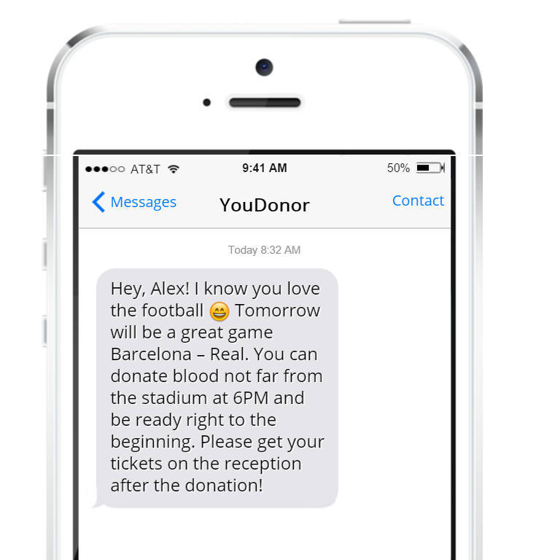
Lack of motivation

Slide 8
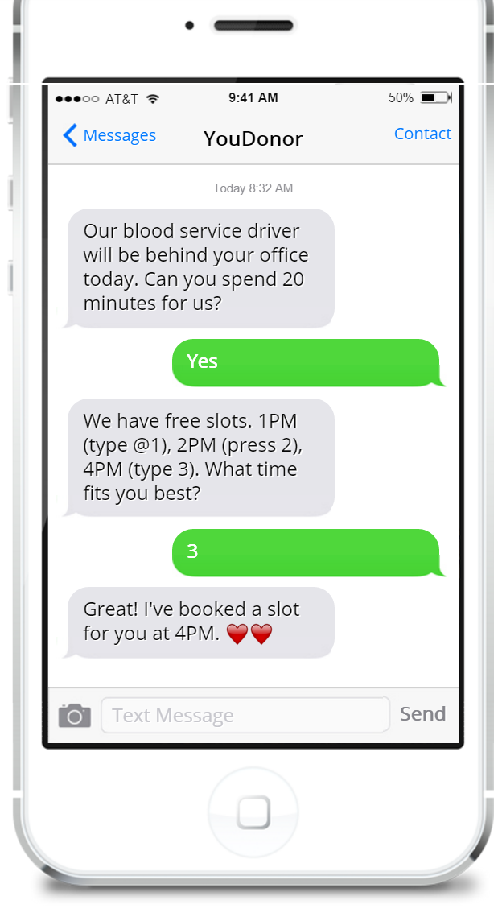
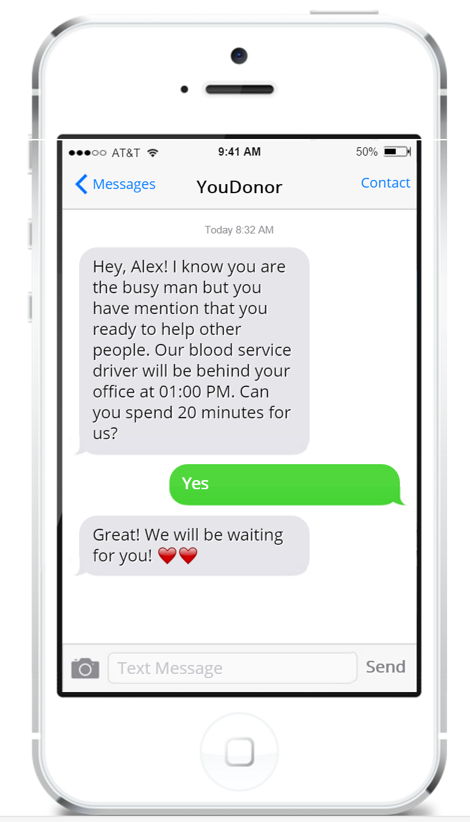
Lack of ability

Slide 9
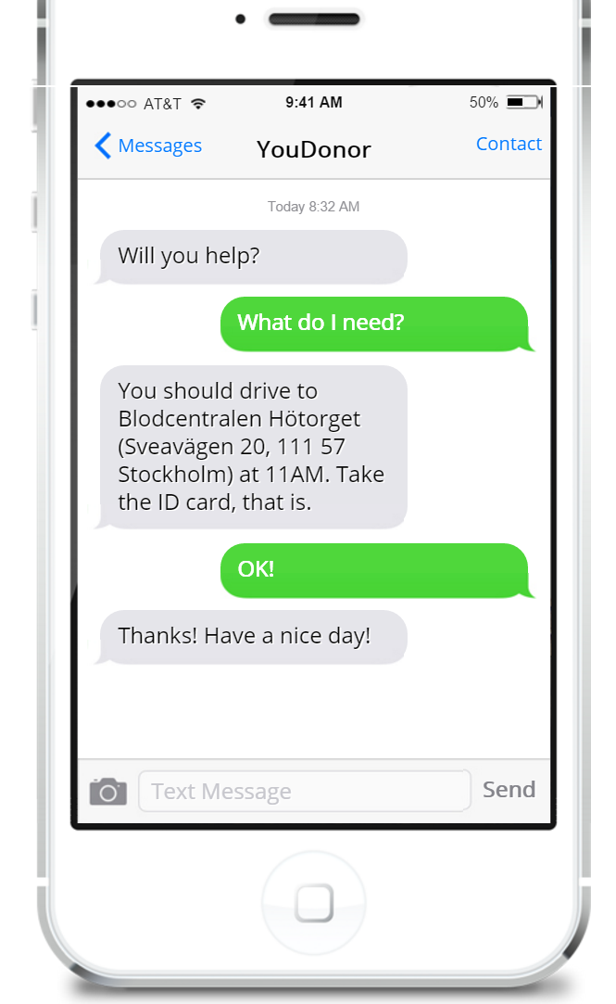
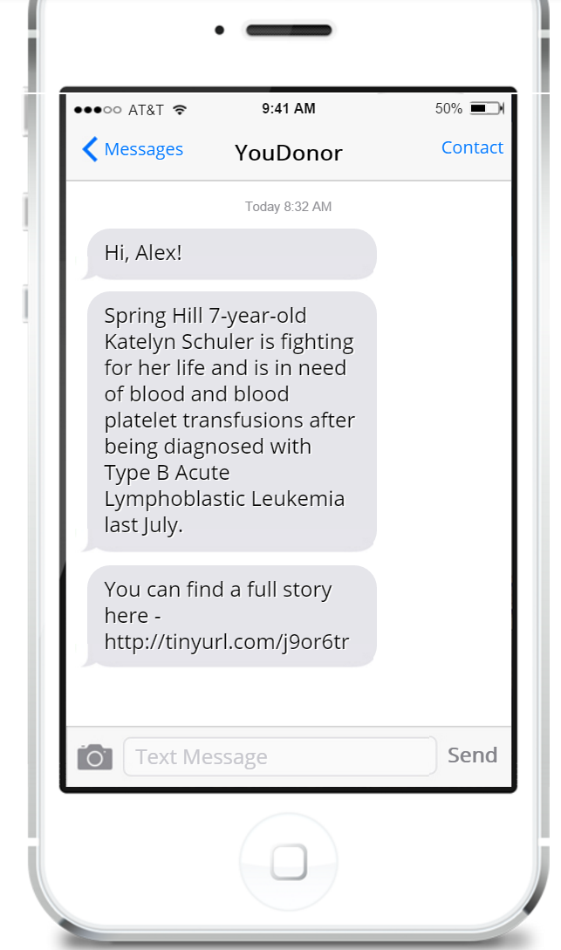
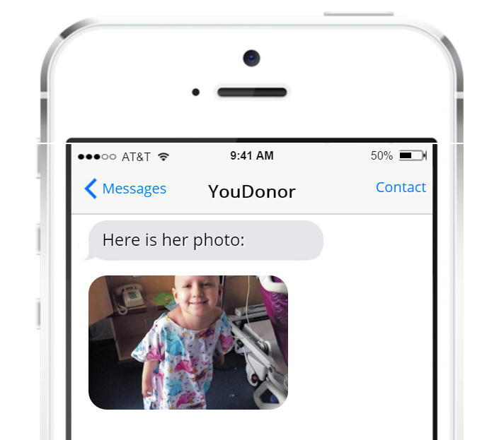
Lack of personalization and direct impact

Slide 10
Business model
Direct sales to NGOs, Red Cross, government health institutions for conducting special campaigns or using our system on top of existing ones.
It can be subscription model (pay monthly and use) or recruitment-based ($N/recruitment, recruit as many donors as you need).
Personal or center based subscription.

Slide 11
Marketing strategy
Using of bot system
Standard channels: contextual advertising, social networks, media publications, public presentations.
Promotional activities (on regular basis).
Creation of socially-oriented content (video, texts).
Agreements with Focus magazine, Ukrainian media holding and others for promotion of the product.
Usage of program marketing opportunities for startups Microsoft BizSpark (3 years).
Direct Sales - Ongoing agreements with blood centers.

Slide 12
Traction since March 2015
200%+ registered blood donors
400%+ needed recipients
20 minutes takes to find blood donor for selected cities
480% weekly total reach in Facebook
1000 users per day on website
3,5 minutes average session duration
3,82 pages per session

Slide 13
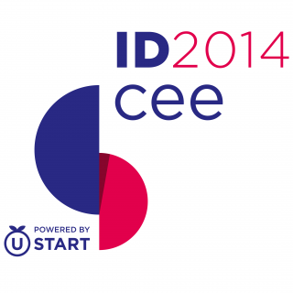






Awards and visibility
The winner of hackhaton SocialBoost at IDCEE conference 2014.
The best technological solution in social projects sphere
and NGOs within the contest from GURT (www.gurt.org.ua)
and Microsoft Ukraine
The winner of Stockholm Startup Weekend: Social Innovation 2016
More than 50 references in the media and TV

Slide 14
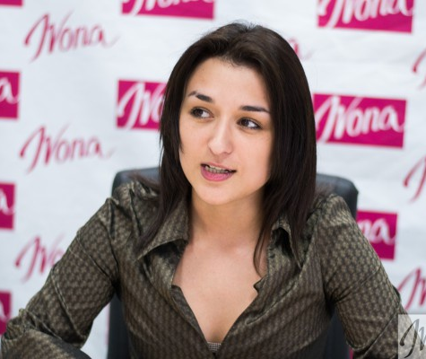
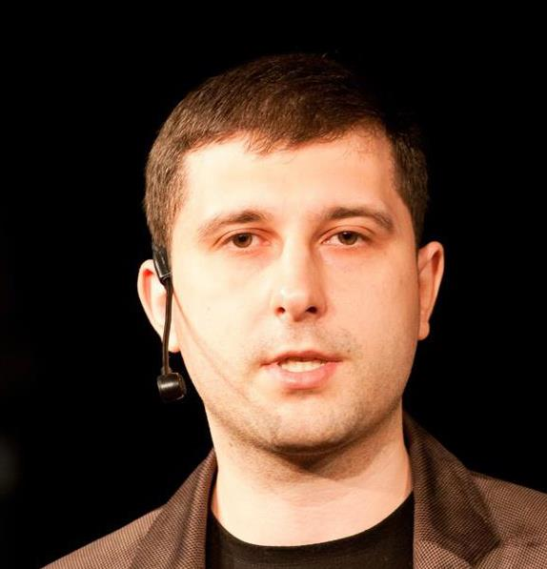
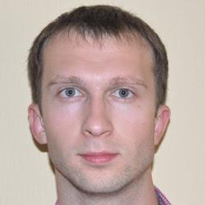
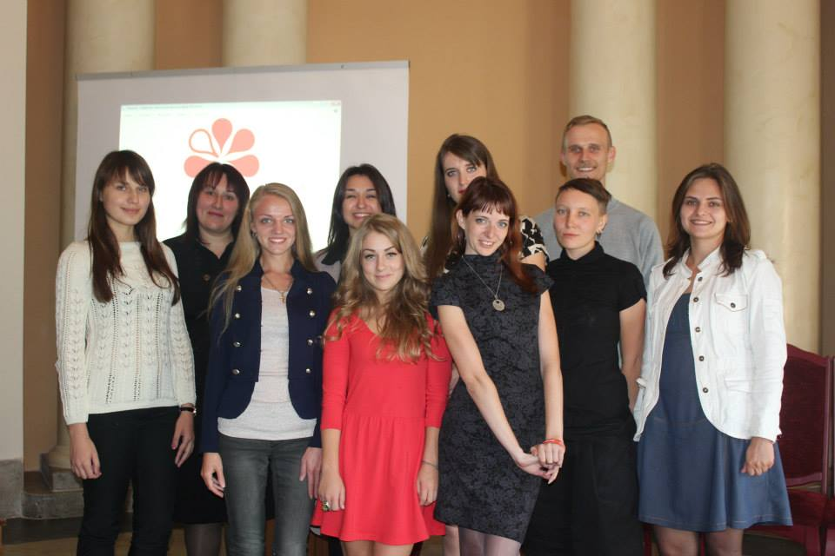
Team
Oleksandr Krakovetsky,
CTO at DonorUA
founder at IT company DevRain Solutions.
Microsoft Regional Director
Mihail Galushko,
co-founder at DevRain Solutions, Microsoft Most Valuable Professional.
Iryna Slavinska
CEO at DonorUA
President at All-ukrainian youth NGO “Association of young blood donors of Ukraine”.
Designer 2 programmers
QA 10 co-workers

Slide 15
Competitors
Small projects, thematic groups in social networks as: http://donor.org.ua/, http://molodost.in.ua/onko/donorstvo/, http://vk.com/donors_in_kyiv.
Foreign prototypes: http://www.podari-zhizn.ru/, http://www.yadonor.ru/, https://donorsearch.org/ (Russia), http://www.iicd.org/projects/zambia-znbts (Zambia), http://tsu.trp.nic.in/blood/don_search.asp (India), http://www.medicalexpo.com/prod/haemonetics/management-software-medical-blood-transfusion-center-78504-520950.html (США).
Thematic company’s projects, that are not their core business, e.g. “Life line” by MTS Ukraine http://donor.mts.ua/ua.

Slide 16
Product Readiness Status
Blood donors basis (> 4000).
Website https://donor.ua.
Web OData API http://donor.ua/api.
Statistics http://donor.ua/statistics.
Notification & recommendation system.
Open data.
Social monitoring tool.
Integration with blood centers – Q3 2016
Bot system – Q3 2016

Slide 17
Investments (first year)
Item | Budget
Bot system | 20000$
Marketing events | 15000$
Direct sales marketing | 20000$
PR | 20000$
Operational activity | 15000$
Notification & recommendation system improvements | 20000$
Total: | 110000$

Slide 18
Contacts
info@donor.ua
alex.krakovetskiy@donor.ua
i.slavinska@donor.ua
+38 (063) 26 55 367
Skype: alex.krakovetskiy
https://www.f6s.com/udonors/
https://www.facebook.com/udonors/
http://angel.co/udonors

